Slide 1
The essay: reason/logic/facts/claims & evidence

Slide 2
CLAIMS
The claim is like the thesis; it is the author’s assertion about what should be felt/done about a situation.
You could think about it as linked to purpose and why the writer is writing. To…
Sometimes it’s stated explicitly, and other times, it’s implied.
EXPLICIT: Carter CLAIMS that the Arctic Wildlife Refuge must be preserved.
IMPLICIT: Elie Wiesel’s Night makes an implicit claim that the horrors of the Holocaust must not be forgotten so as not to be repeated.

Slide 3
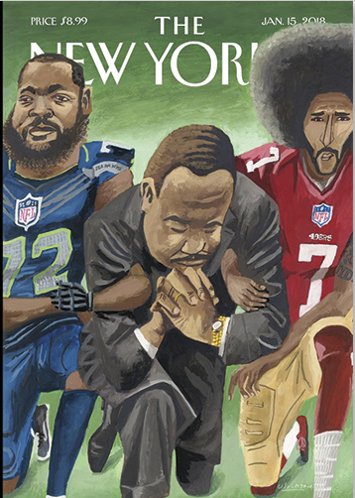
Remember the New Yorker cover?
What IMPLICIT claim does it seem to be making?

Slide 4
CONCESSION
A writer may make a concession, or an acknowledgment of the opponent’s perspective:
To be fair
To allow for multiple perspectives to be considered
To destroy it and affirm one’s one stance
EXAMPLE: Dad, I know taking a trip to another country with my friends may be expensive and unsafe, but I have studied so hard the past year and I think I deserve a vacation. You already know how responsible I have been all my life; I don’t think there will be any problem.

Slide 5
REASON with argument
When you read a piece that makes a claim, look for:
How a writer provides reasons/support
How a writer may anticipate the counterclaim (the opposing viewpoint)
How a writer refutes the counterclaim/how the writer takes down the points of the opposition
How a writer makes a concession (acknowledges the other side’s point)

Slide 6
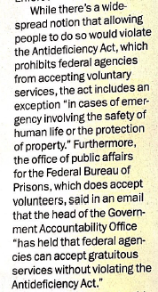
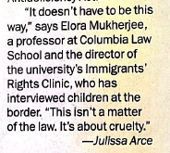
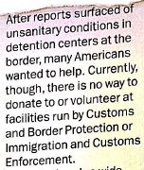
SAMPLE: Time, 7/29/19
What is the author’s claim?

